Slide 1
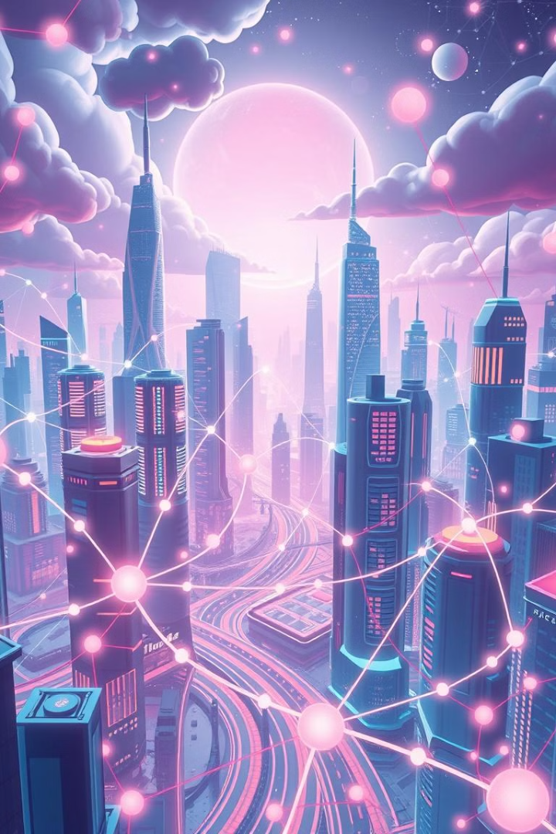
Blockchain and Web 3.0: Decentralizing the Future
Explore the transformative power of blockchain and Web 3.0.
These technologies are reshaping the internet and finance.

Slide 2
Introduction to Blockchain and Web 3.0
Blockchain
Web 3.0
A distributed ledger technology.
The next generation of the internet.
It ensures secure, transparent, and tamper-proof transactions.
It focuses on decentralization, user ownership, and blockchain integration.

Slide 3

Key Features of Blockchain
1
Decentralization
2
Transparency
No central authority.
All transactions are publicly viewable.
Control is distributed across a network.
3
Security
4
Immutability
Cryptography protects data integrity.
Once recorded, data cannot be changed.
This prevents tampering.

Slide 4
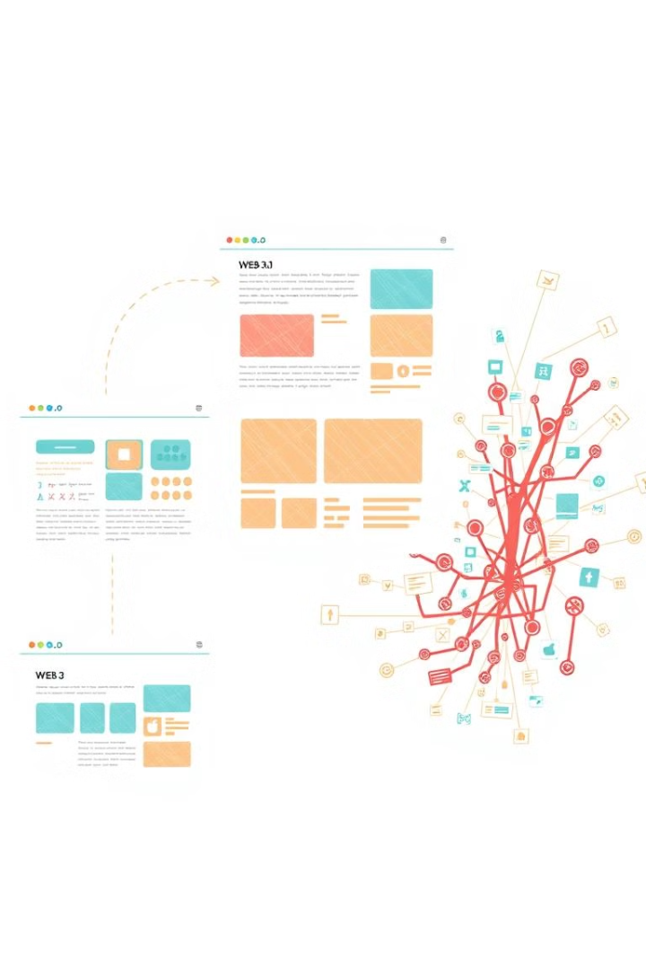
Web 1.0, 2.0, and 3.0
1
Web 1.0
Static pages, limited interaction.
Read-only web.
2
Web 2.0
Social media platforms emerged.
Users generate content but platforms control data.
3
Web 3.0
Decentralized web.
Users own their data.

Slide 5

Decentralized Finance (DeFi)
What is DeFi?
Key Components
Financial services on the blockchain.
DEXs, lending/borrowing platforms, and stablecoins.
Peer-to-peer transactions without intermediaries.

Slide 6

Benefits of DeFi
1
Accessibility
2
Lower Costs
Anyone with internet access can participate.
Fewer intermediaries mean reduced fees.
3
Transparency
All transactions are verifiable.

Slide 7
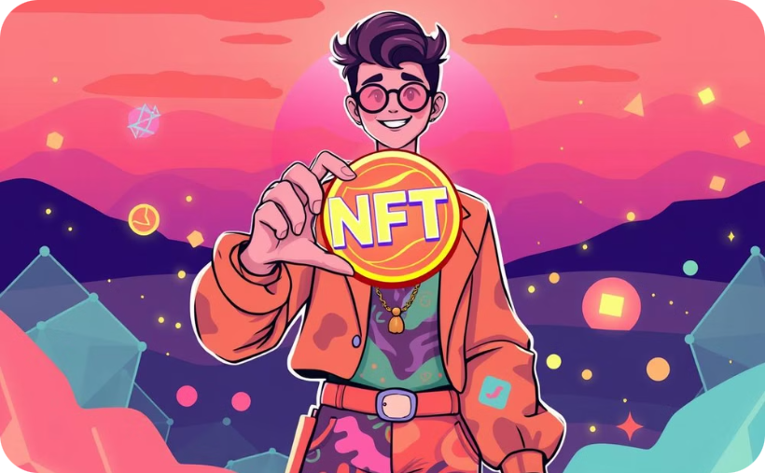

NFTs in Art and Gaming
Art
Gaming
Artists tokenize their work.
Players can own and trade in-game items as NFTs.
This ensures provenance and enables direct sales.

Slide 8
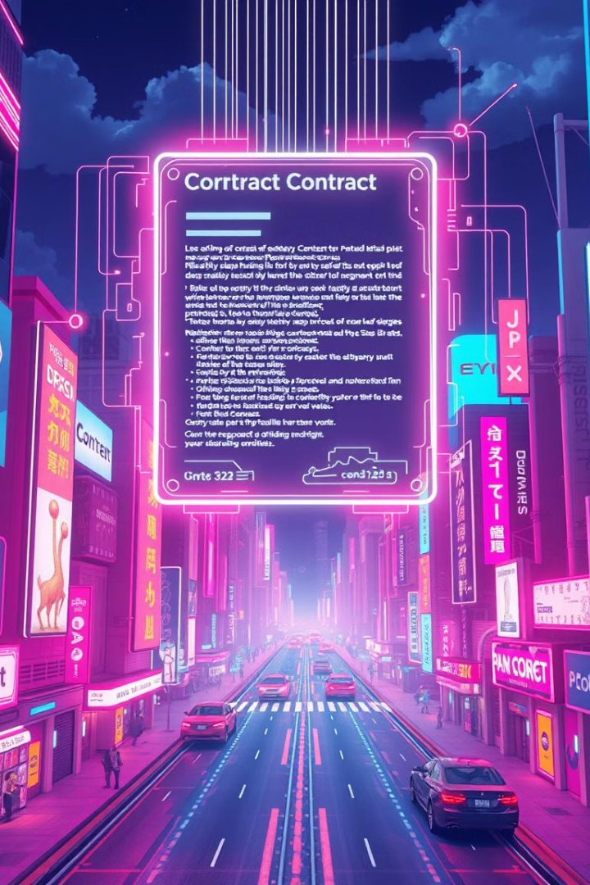
Smart Contracts
What are Smart Contracts?
How They Work
Execute automatically when conditions are met.
Self-executing contracts written in code.
Applications
Supply chain, real estate, insurance, and more.

Slide 9

Challenges and Risks
1
Scalability
2
Regulation
Blockchains can struggle with high transaction volumes.
Governments are still developing regulatory frameworks.
3
Security
Hacks and exploits are a concern.

Slide 10
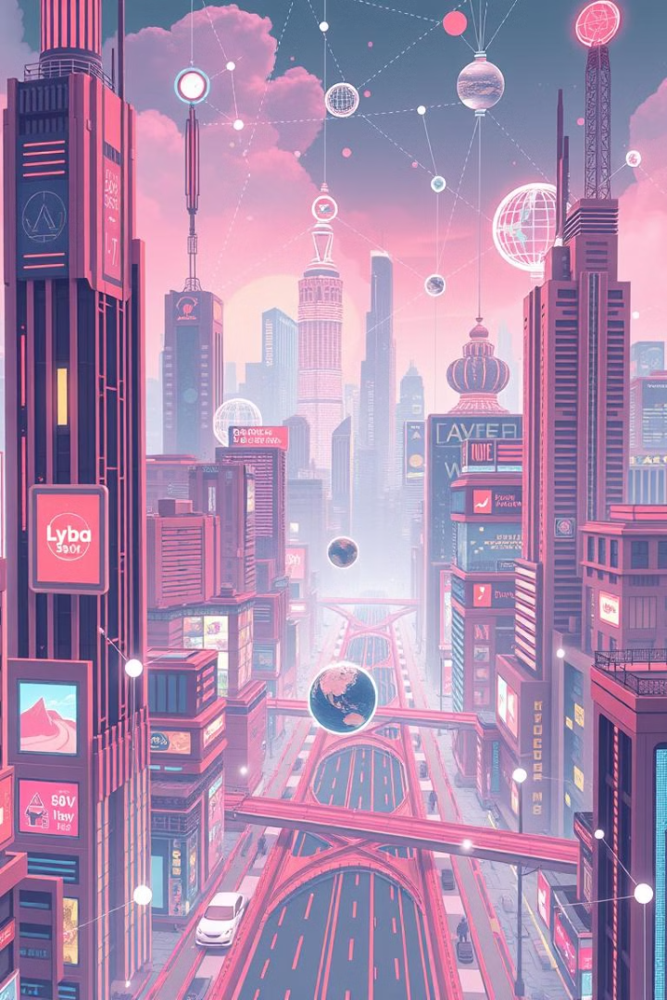



Future of Blockchain and Web 3.0
Interoperability
Connecting different blockchains.
Energy Efficiency
Transitioning to Proof of Stake.
Mainstream Adoption
More industries are exploring blockchain.

